Slide 1
Databases 2
NoSQL

Slide 2
Definition
Not Only SQL or NOT SQL
Traditional databases have certain challenges and restrictions
What are traditional databases?
Notes:
Traditional databases = RDBMS = Relational databases

Slide 3
Definition
“Three database admins walked into a NoSQL bar… A little while later they walked out because they couldn’t find a table”
Notes:
Traditional databases = RDBMS = Relational databases

Slide 4
Agenda
Traditional databases
NoSQL
NoSQL database types
CAP Theorem
Using MongoDB
Notes:
Traditional databases = RDBMS = Relational databases

Slide 5
Traditional databases
Not optimized for horizontal scaling
Not able to handle semi-structured or unstructured data
Lacks performance on big data sets
What is the opposite of horizontal scaling and could you give an example?
Notes:
Horizontal scaling = Multiple servers
Vertical scaling = More RAM/HD in 1 server

Slide 6
Traditional databases
What types of traditional (RDBMS) databases do you know?
Notes:
Oracle, Microsoft SQL Server, MySQL, etc.

Slide 7
Traditional databases
Traditional databases are all built very similar
PK’s, FK’s, Indices
Tables, Columns, Rows
Etc..
NoSQL databases has different variations
For different types of use-cases

Slide 8
NoSQL - Features
Generic Data Model
Works with sets, maps and arrays instead of references to a different table
Non-related and de-normalized
Data is stored in a single table so no joins are needed
Highly distributable
Can store and process a set of data on more than once device
Notes:
Horizontal scaling = Multiple servers
Vertical scaling = More RAM/HD in 1 server

Slide 9
NoSQL - Database Types
Document Database
Graph stores
Wide-column stores

Slide 10
NoSQL - Document database
Pair each key with a complex data structure known as a document
Documents can contain many different key-value pairs or key-array pairs or even nested documents
Support for embedded documents
Consumes more space as compared to counterparts
MongoDB is an example

Slide 11
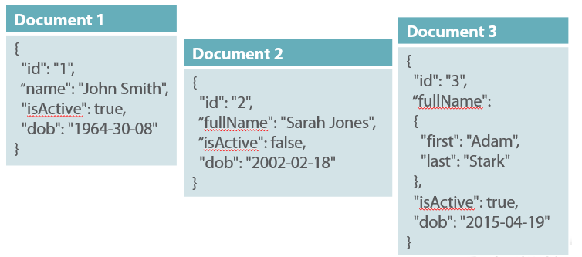
NoSQL – Document database
Notes:
Different schemas

Slide 12
NoSQL – Graph stores
For very specific use cases; not suited for all problems
Store information about connected data / networks of data
Most comparable to relational databases due to the relations
Example case: social network connections like Twitter with friends, posts, likes, etc.
Example: Neo4J

Slide 13
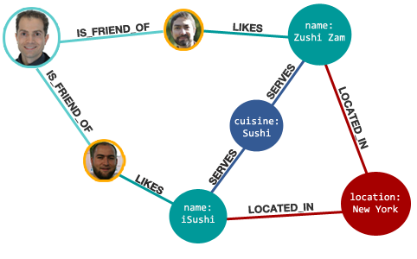
NoSQL – Graph stores

Slide 14
NoSQL – Wide-column stores
Store columns of data together, instead of rows
Excellent for lookups on a single field
Lookup on other fields not supported
Example: Cassandra / HBase

Slide 15
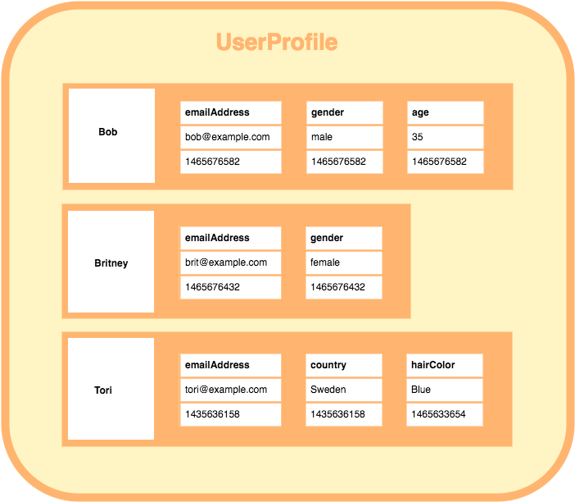
NoSQL – Wide-column stores

Slide 16
NoSQL – Quiz
3 Questions
Write down your answers
Quiz incoming in 3..2..1..
Notes:
Ask for answers for every question

Slide 17
NoSQL – Question 1/3
Which of the following is a challenge with traditional RDBMS?
Not optimized for scaling
Not able to handle unstructured data
Unable to analyse data quickly
Costly
Notes:
1,2,4

Slide 18
NoSQL – Question 2/3
Which of the database is a graph database?
Hbase
Neo4J
Cassandra
MongoDB
Notes:
2: Neo4J

Slide 19
NoSQL – Question 3/3
Which of the following is a database type that supports nesting?
Graph databases
Wide-column stores
Column-oriented databases
Document based databases
Notes:
Nesting = A database of type A inside a database of type A (Something inside itself)
4: Document based databases

Slide 20
NoSQL – CAP Theorem
NoSQL databases are meant for distributed storage
100,000 rows in total
Machine 1: 1 – 25,000
Machine 2: 25,001 – 50,000
Machine 3: 50,001 – 75,000
Machine 4: 75,001 – 100,000
Etc..

Slide 21
NoSQL – CAP Theorem
Consistency
Data in database remains consistent after for example an update operation.
Availability
System is always on, no downtime
Partition Tolerance
System continues to function, even if the communication among the servers is unreliable

Slide 22
NoSQL – CAP Theorem
Example: Machine 1 for rows 1 – 25,000 is down.
You can increase the availability by storing the data on multiple machines
However, this means there is duplicate data so the consistency decreases
It can take a while before an update on machine 1 is being propagated to a mirror machine

Slide 23
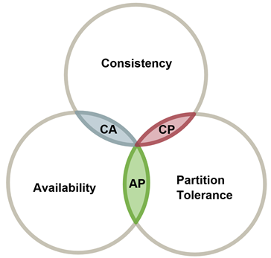
NoSQL – CAP Theorem
You have to choose 2 out of 3 quality values

Slide 24
NoSQL – CAP Theorem
Partition Tolerance is mandatory for distributed databases
Which means that CP and AP are left to choose from

Slide 25
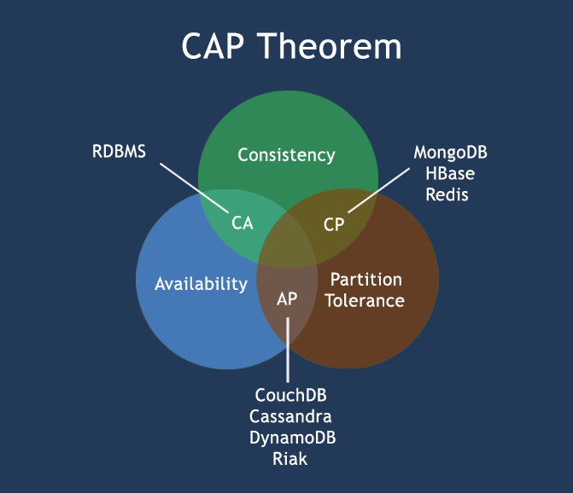
NoSQL – CAP Theorem

Slide 26
NoSQL – CAP Theorem
We have 1000 applications which access a NoSQL database for lookup. The content is static and is not getting updated frequently.
Which category should we use?
Consistancy & Availability
Availability & Partition Tolerance
Consistancy & Partition Tolerance
Notes:
2: AP; Because Partition Tolerance is needed for NoSQL and Consistancy has no priority because the content is almost static

Slide 27
NoSQL – MongoDB
Download MongoDB from mongodb.com
Choose Community Server
Windows Server 2008
Install MongoDB
Install Compass
Remember where you installed it
Notes:
Compass = GUI

Slide 28
NoSQL – MongoDB
Run MongoDB from the command line
Go to the path where you installed it
Run “mongod”
“exception in initAndListen: NonExistentPath: Data directory C:\data\db\ not found., terminating”

Slide 29
NoSQL – MongoDB
Run MongoDB
Create the folders on your hard drive
Run “mongod”
“exception in initAndListen: NonExistentPath: Data directory C:\data\db\ not found., terminating”

Slide 30
NoSQL – MongoDB
Run MongoDB Compass
Keep the default values
Run Connect
Create new database
Database Name: Databases2
Collection Name: Name of your first collection
Capped collections: Off

Slide 31
NoSQL – MongoDB
Insert data
Press “Insert document”
Specify columns and rows in JSON-format
Press “Insert”
Notes:
Colums and rows can differ between documents

Slide 32
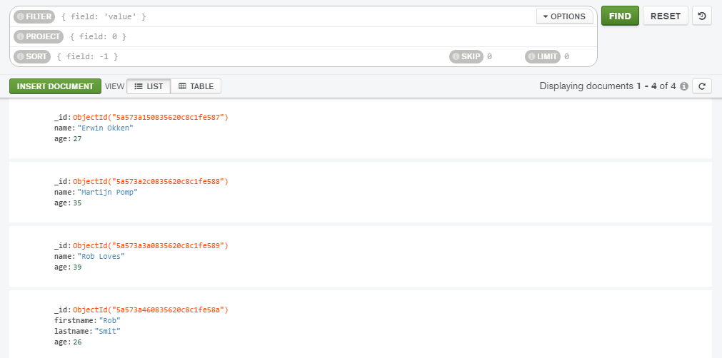
NoSQL – MongoDB

Slide 33
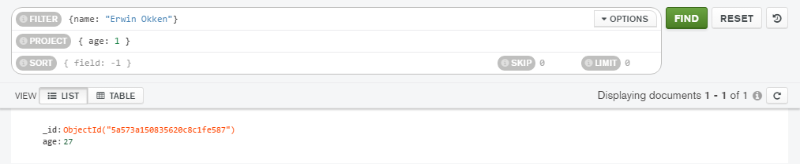
NoSQL – MongoDB
Query data
Filter: WHERE
Project: SELECT age FROM table
Sort: ORDER BY
Skip/Limit: Equivalent to *SQL
Notes:
Filter: Conditions
Project: 1 to get, 0 to ignore. 0 and 1 cannot be mixed
Sort: -1 for descending, 1 for ascending
Skip/Limit: Pagination

Slide 34
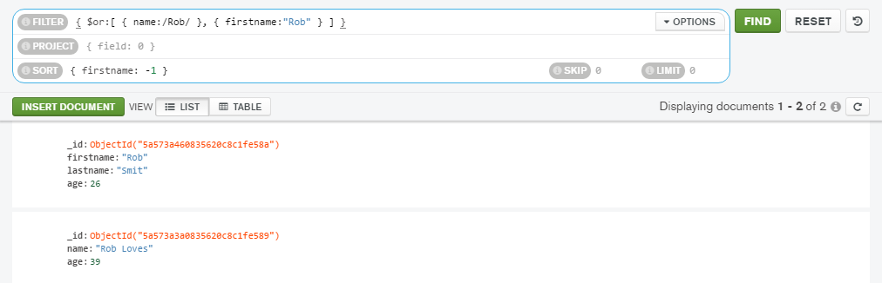
NoSQL – MongoDB
Query data (advanced)
$or: WHERE condition OR condition
/Rob/: WHERE name LIKE ‘%Rob%’
Sort: Descending on firstname
Notes:
Regular expressions = very advanced search mechanism supported in a broad way;

